Slide 1

Access Provider Platform
Presented By-
DEBLINA KARMAKAR (1427965)
INDRANIL SAHA (1427190)
ANKITA BHOSALE
NASIR ISAQ
TIEN SON
Examined By-
Prof. Dr. PATRICK WACHT

Slide 2
AGENDA
Definition of Agile Software Development
Agile Methodologies
Advantages of Scrum & Kanban in Agile
Requirements
Use case diagram

Slide 3
Definition of Agile software Development
Iterative and flexible approach in the world of software development against traditional linear development
Key Technologies
Iterative Development
Collaboration
Adaptability
Continuous Development
End user involvement
Interaction between Teams

Slide 4
Agile Methodologies
Scrum
Include roles (Product Owner, Scrum Master, Development Team), artifacts (Product Backlog, Sprint Backlog, Increment), and ceremonies (Sprint Planning, Daily Standup, Sprint Review, Sprint Retrospective) of project.
Kanban
Emphasizes visualizing the workflow on a Kanban board, where work items move through different stages (columns) from the backlog to completion.

Slide 5
Advantages of using Scrum in Agile
Predictability and Transparency for project progress
Permits modifications to the project's objectives, priorities, and requirements at each sprint.
Culture of continuous Improvement
Sprint Reviews facilitates feedback and adjustment
Communication fosters a shared understanding of project goals among team members.

Slide 6
Advantages of using Kanban in Agile
Flexibility and continuous flow based on priorities
Reduced Work in Progress (WIP) and Bottlenecks
Efficient Resource Utilization on limiting WIP
Visual Management of task and Identify potential issues

Slide 7
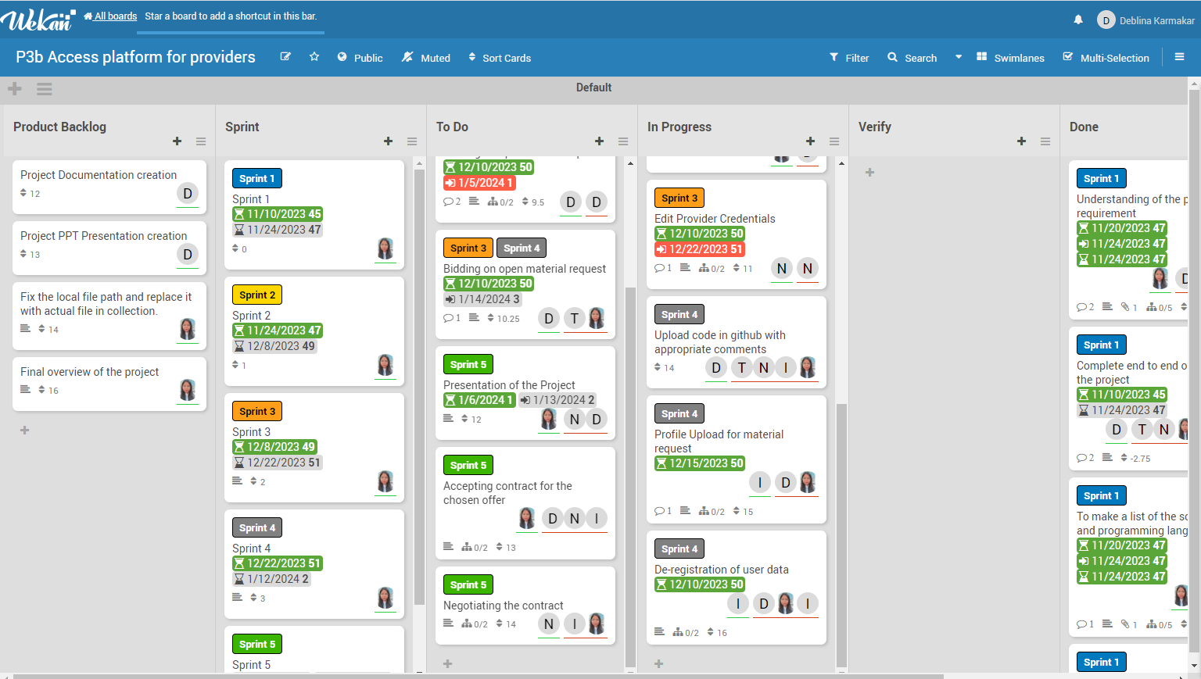
Kanban Board Visual

Slide 8
Requirements
User can login using authentication component and Provider Admin can edit provider credentials
User can see master agreement and provide an offer to establish the master agreement.
User can bid on open service requests and material request
Upload of employee profiles for service requests and responses to material requests
User accepts contract if offer has been chosen and negotiation can take place

Slide 9
First Use Case Diagram
Registration
Login
Bid Active MA
APP
Edit Profile Info
Accept/Reject Master Agreement
Access Master Agreement
Provide Daily Rate

Slide 10
Second Use Case Diagram
Access Open Services
Provider
Add Employees
Negotiate & Offer Employees
Logout

Slide 11
Thank You

Slide 12
Customize this Template
Template Editing Instructions and Feedback

